Slide 1
Let’s make it a great day!
Wednesday, May 27, 2015

Slide 2
Jeopardy
Heeeeeeere we go! We are going to play Jeopardy today to prepare for our class
Answer Sheets: you will all receive a blank answer sheet to write down the answers to the questions
Questions will be online by tonight (so you will only have to write in the answer to save time)

Slide 3
The questions
I have ordered the questions a little more in levels of difficulty
The 500 point questions (for the most part) require slightly deeper thinking, and your responses will have to be more thorough

Slide 4
Let’s begin!
THIS
IS
JEOPARDY

Slide 5
Jeopardy
People | Reconstruction Economics | Terms | Freedom | Random
100 | 100 | 100 | 100 | 100
200 | 200 | 200 | 200 | 200
300 | 300 | 300 | 300 | 300
400 | 400 | 400 | 400 | 400
500 | 500 | 500 | 500 | 500

Slide 6
People - 100
The president who was impeached for breaking the Tenure of Office Act
He was not convicted/removed from office.
Notes:
Category 1 - 10

Slide 7
People - 200
The president who came up with the phrase ‘reconstruction’
Notes:
Category 1 - 20

Slide 8
People - 300
This president’s terms were riddled with corruption from members of his cabinet.
He liked to do some 19th Century drag racing himself.

Slide 9
People - 400
What was similar between the presidencies of Andrew Johnson and Gerald Ford?

Slide 10
People - 500
What group of people helped make a strong push for African-American rights?

Slide 11
Reconstruction Economics- 100
What is Share Cropping?

Slide 12
Reconstruction Economics- 200
Explain what tenant farming is.

Slide 13
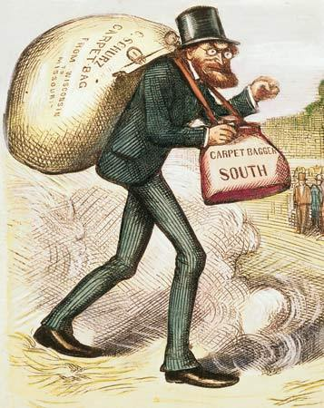
Reconstruction Economics- 300
What does this cartoon represent? What is this man doing, anmd where is he going?

Slide 14
Reconstruction Economics- 400
Name three economic problems the United States faced in the aftermath of the Civil War.

Slide 15
Reconstruction Economics- 500
Explain what caused the Panic of 1873, as well as what it resulted in.

Slide 16
Terms- 100
What does ‘scalawag’ mean?

Slide 17
terms- 200
What is a carpetbagger? How were they viewed at the time?

Slide 18
terms- 300
Explain what the term ‘home rule’ meant, and it’s relationship to the reconstruction era.

Slide 19
terms - 400
Explain the effect the Ku Klux Klan had on Reconstruction.

Slide 20
terms- 500
Who was Hiram Revels?
Explain what his job would have been like for him- what difficulties was he facing?

Slide 21
Freedom- 100
What law gave all slaves their freedom throughout the entire United States?

Slide 22
Freedom- 200
Which political party did the majority of African-Americans affiliate with during the post-War era?

Slide 23
Freedom- 300
What group of programs built roads, schools, bridges, and other buildings/infrastructure after the War ended?

Slide 24
Freedom- 400
What were black codes? What was the relationship between black codes and the Fourteenth Amendment?

Slide 25
Freedom- 500
Explain what effect African-Americans had on the Elections of 1868 and 1872.

Slide 26
Random- 100
Who were Rutherford B. Hayes and Samuel J. Tilden?

Slide 27
Random- 200
What was the Fifteenth Amendment?

Slide 28
Random- 300
Explain two reasons why Ulysses S. Grant won his two elections.

Slide 29
Random- 400
What was the relationship between the Wade-Davis Bill and Reconstruction?

Slide 30
Random- 500
Name two of the lasting legacies of Reconstruction.

