Slide 1
American Civil War

Slide 2
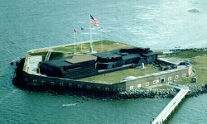
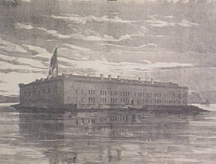
Fort Sumter
Sumter today
The first engagement of the Civil War took place at Fort Sumter on April 12 and 13, 1861. After 34 hours of fighting, the Union surrendered the fort to the Confederates. From 1863 to 1865, the Confederates at Fort Sumter withstood a 22 month siege by Union forces. During this time, most of the fort was reduced to brick rubble.
Old Fort Sumter

Slide 3
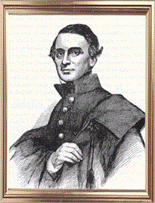
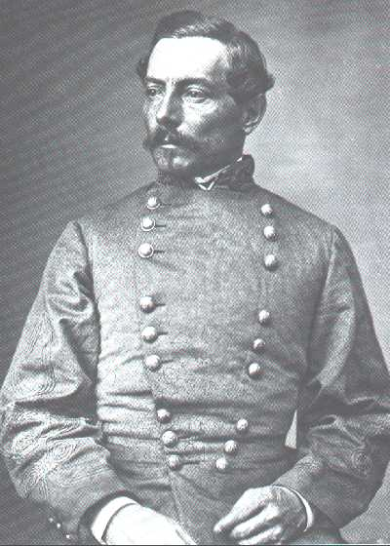
Fort Sumter
Charleston Harbor,
South Carolina
Union Commander: Major Anderson
Confederate Commander:
General Beauregard
April 12-14, 1861
Casualties:None
Winner:Confederate

Slide 4
Significance:
First battle of Civil War.
Raised false hopes for a quick war.
Lincoln then asked for 100,000 volunteers.
General Beauregard was a student of Major Anderson while at Westpoint...weird!!

Slide 5
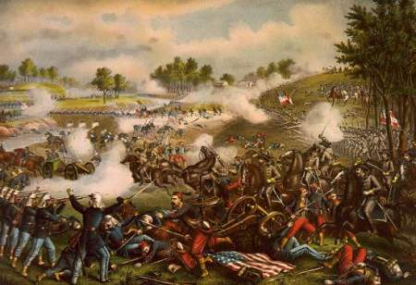
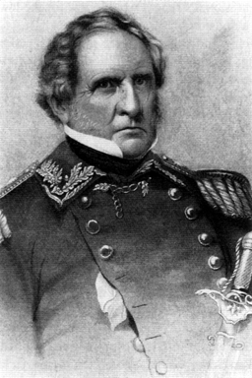
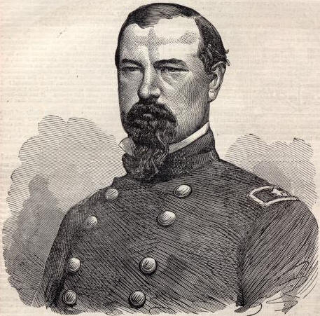
First Bull Run
First Battle of Bull Run July 1861
Public demand pushed General-in-Chief Winfield Scott to advance on the South before adequately training Union troops. Scott ordered General Irvin McDowell to advance on Confederate troops stationed at Manassas Junction, Virginia. McDowell attacked on July 21, and was initially successful, but the introduction of Confederate reinforcements resulted in a Southern victory and a chaotic retreat toward Washington by federal troops.

Slide 6
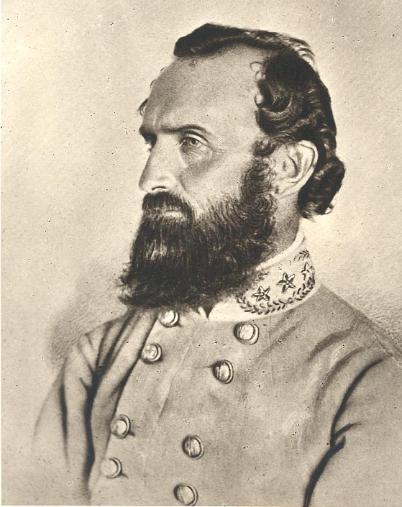
First Bull Run
Manassas, Virginia
Union Commander: General Irwin McDowell
Confederate Commander: General Joe Johnston July 21, 1861
Casualties: Union-2,446, Confederate-1,600
Winner: Confederate
Stonewall Jackson

Slide 7
Significance:
First large battle of the war.
Confederates routed an unprepared Union force.
Casualties shocked the North and South.
They now believed the war would not be quick nor easy.
During this battle, General Thomas J. Jackson earned the name, “Stonewall” by inspiring his troops to stand firm under the Union attack.

Slide 8
Shiloh
Shiloh was a decisive and bloody battle. The South needed a win to make up defeats in Kentucky and Tennessee. It also needed to stop the Union’s attack down the Mississippi Valley. Memphis and Vicksburg were now vulnerable, and after Corinth there was now doubt that those cities would be the next targets.
Johnston and Beauregard made a surprise attack while the Union rested. Grant and his men lost their over-confidence after this near defeat. They now knew that this war was going to be, in the words of a Union Soldier, "A very bloody affair."

Slide 9
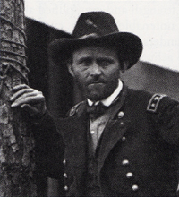
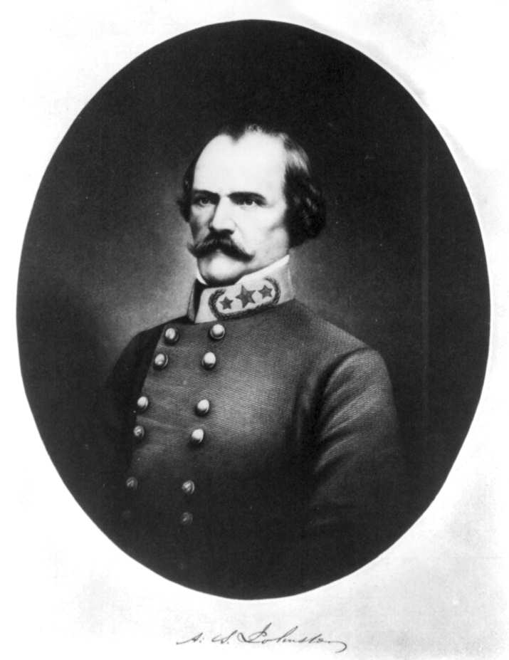
Shiloh, Tennessee
Union Commander:
General Ulysses Grant
Confederate:
General Albert Sydney Johnston
April 6-7, 1862
Casualties:
Union-13,047
Confederate-10,694
Winner: Union

Slide 10
Significance:
The first battle with truly large casualties. The casualties were higher than any America had ever seen.
Grant temporarily lost his position in command.

Slide 11
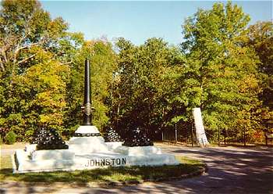
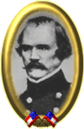
To the right is a monument where he fell.
General Albert Sydney Johnston was considered the finest general in either army before the war began. He bled to death on the first day of Shiloh from a wound to the leg while leading a charge through an orchard.

Slide 12
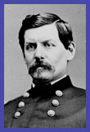
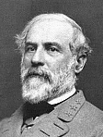
The single bloodiest day of the Civil War
Antietam
Generals McClellan and Lee

Slide 13
Lee invaded Maryland hoping the state would help the South. Instead, Lee was pinned down at Antietam creek by George McClellan after his plans were discovered wrapped around some cigars.
2nd Bullrun

Slide 14
Antietam Creek
Sharpsburg, Maryland
Union Commander: General George McClellan
Confederate Commander:General Robert E. Lee
September 17, 1862
Casualties: Union-12,410 Confederate-13,724
Winner: Union…barely!

Slide 17
Significance:
One of only 2 major battles fought in the North.
The bloodiest day of the war.
The Union forced Lee back to the South.
This victory was what Lincoln needed to issue the Emancipation Proclamation.

Slide 18
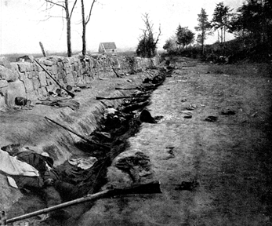

Slide 19
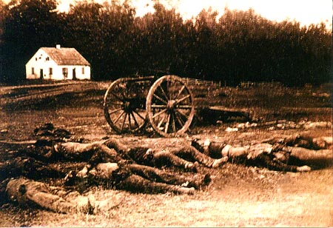
Antietam Creek

Slide 20
Chancellorsville
General Joseph Hooker took control of the Union Army after General Burnside made his blunder at Fredericksburg. One part of his army crossed the Rappahannock south of Fredericksburg, the other crossed the river 12 miles to the north at Chancellorsville. Hooker successfully outflanked Lee. Or so he thought….

Slide 21
Chancellorsville, Virginia
At 6 PM on May 2nd, Jackson launched his attack on the unsuspecting Union flank. Meanwhile Jackson himself was wounded by his own men. He died a few days later. Hooker ordered his forces to attack from the south and they were successful in driving back the rebels. This force was ordered to advance and attack Lee's main body from the rear. Unfortunately, the inactivity of Hookers forces in front of Lee allowed him to turn his army to the rear. The Union forces were forced back across the Rappahannock. Once again Lees superior generalship and Union incompetence had bested a Union forces twice his size.

Slide 22
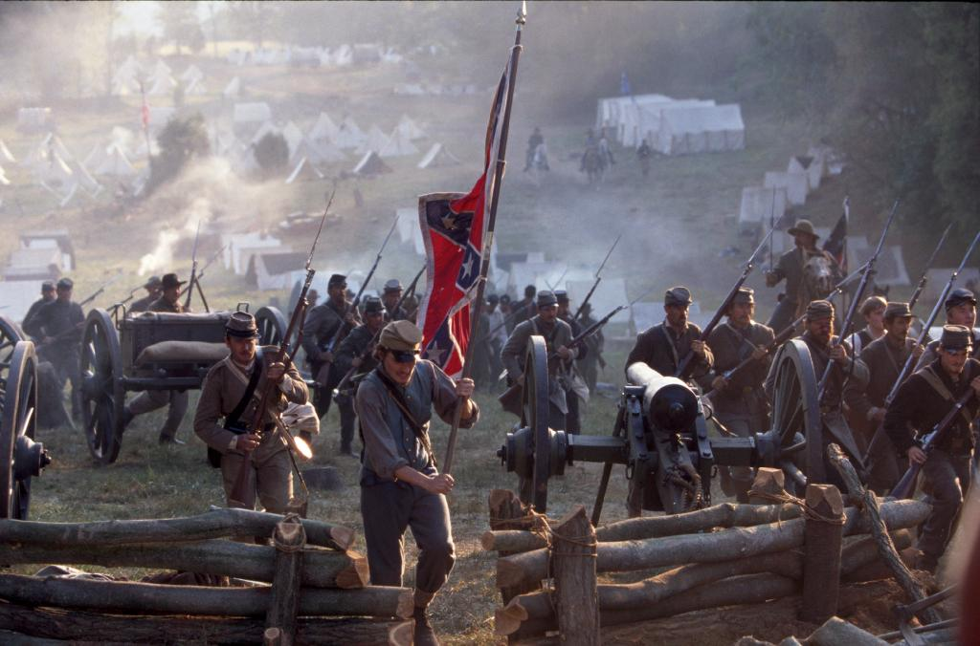

Slide 23
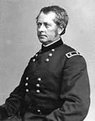
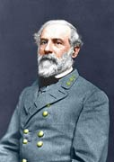
Joseph Hooker
Lee
Chancellorsville, Virginia
Union Commander: General Joseph Hooker
Confederate Commander: Robert E. Lee
May 1-4, 1863
Casualties: Union-17,278 Confederates-12,821
Winner: Confederacy

Slide 24
Significance:
Hooker was out maneuvered by Lee and Stonewall Jackson.
Considered the greatest Confederate victory of the war.
Stonewall Jackson was accidently shot by his own troops. He died a week later.

Slide 25
Vicksburg
At the time of the Civil War, the Mississippi River was the single most important economic feature of the continent. Confederate forces closed the river, which hurt the northern economy.
Grant realized that Vicksburg could not be taken by storm and decided to lay siege to the city. Slowly his army established a line of trenches and dirt forts around Vicksburg and cut it off from supply and communications with the outside world.

Slide 29
Starting in May, Union forces constructed thirteen trenches aimed at different points along the Confederate defense. In June they dug up to the Confederate line, tunneled underneath, and blew up the tunnels filled with black powder to destroy the rebel trenches. The rebels were out of food, out of ammunition and they were clearly losing. They surrendered on July 4th.

Slide 31
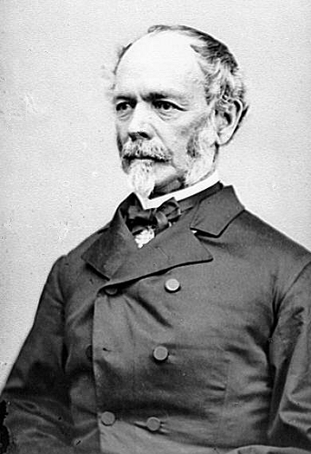
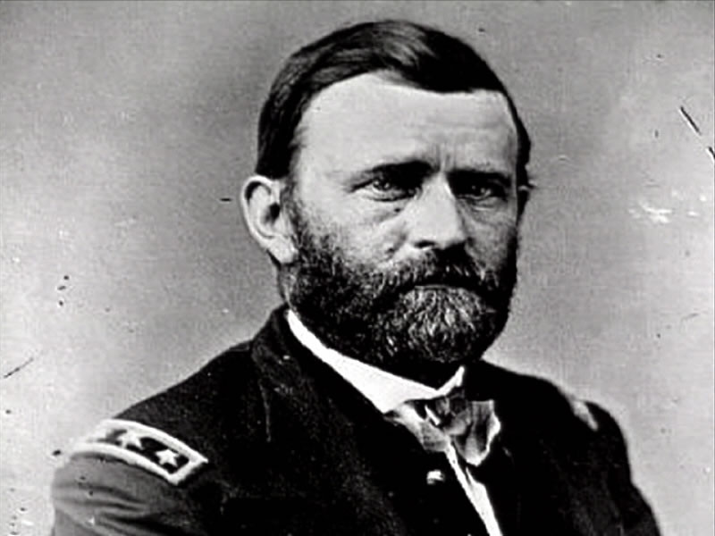
Vicksburg, Mississippi
Union Commander: General
Ulysses Grant
Confederate: General Joseph
E. Johnston
May 19- July 4 1863
Casualties:
Union Casualties: 10,142 Confederate Casualties: 9,091
Winner: Union

Slide 32
Significance:
Grant was bogged down for 3 months
It was the most important victory in the west.
Vicksburg was the key to the Mississippi.
The Confederacy was split in two by the mighty river.

Slide 33
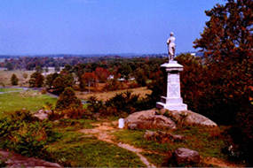
Gettysburg
-
Little Roundtop
Robert E. Lee

Slide 34
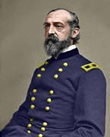
Gettysburg, Pennsylvania
Union Commander :
General George Meade
Confederate Commander:
Robert E. Lee
July 1-3, 1863
Casualties: Union-23,049
Confederate-28,063
Winner: Union

Slide 35
After success at Fredericksburg and Chancellorsville, Lee invades the north again. After trying to break the union lines for 2 days, Lee tries a frontal assault on entrenched union forces. This was known as Pickett’s charge. This attempt failed miserably. Lee ultimately retreats to Virginia.

Slide 37
Significance:
The turning point of the war.
This would be the last chance for the South to win the war and threaten the North.

Slide 38
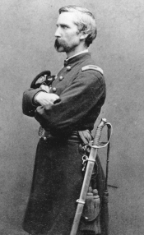
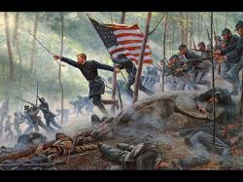
Colonel Chamberlain and the 20th Maine held the extreme left flank of the Union line against a fierce rebel attack, and the surrender of Lee's Army of Northern Virginia at Appomattox, when Grant chose Chamberlain to receive the formal surrender of weapons and colors
Joshua Chamberlain. Former teacher turned hero at Gettysburg.

Slide 39
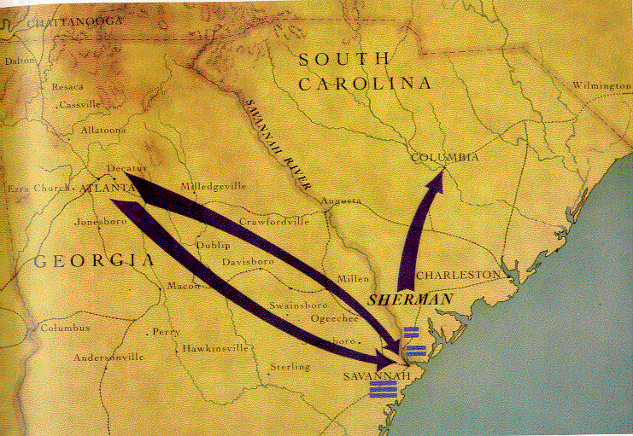
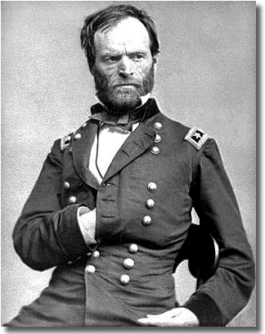
Atlanta (Sherman's march)

Slide 41
Atlanta, Georgia (Sherman’s march to the sea)
Union Commander: General William Sherman
Confederate Commander: General John Hood
July 20-September 2, 1864
Casualties: Union-31,623
Confederate-35,044
Winner: Union

Slide 42
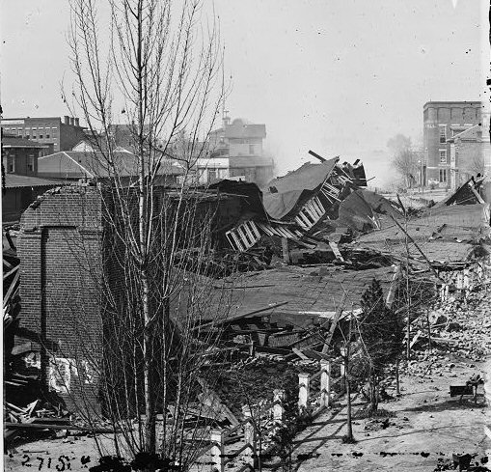
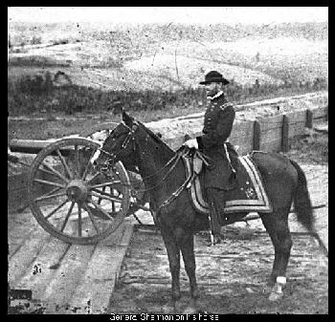
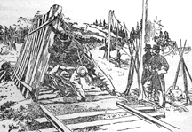
Significance:
The siege of Atlanta by General Sherman ended with the burning of the city by Union troops. After burning the city, Sherman began his famous march to the sea, during which his troops looted and plundered their way across Georgia, destroying nearly everything in their path.

Slide 43
Surrender at Appomattox
On April 9, 1865 Robert E. Lee surrendered his army of Northern Virginia in a little village called Appomattox Courthouse. Lee surrendered formally to Ulysses S. Grant. The papers of formal surrender were signed in the home of Wilmer Mclean, whose first house was damaged during the first battle of the Civil War.

Slide 45
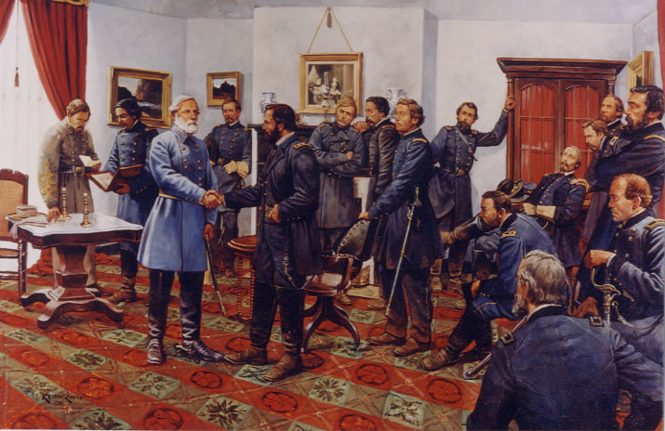

Slide 46
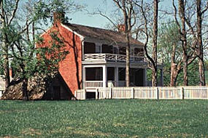
Appomatox Courthouse, Virginia
Lee surrendered to Grant in this home.

